Slide 1
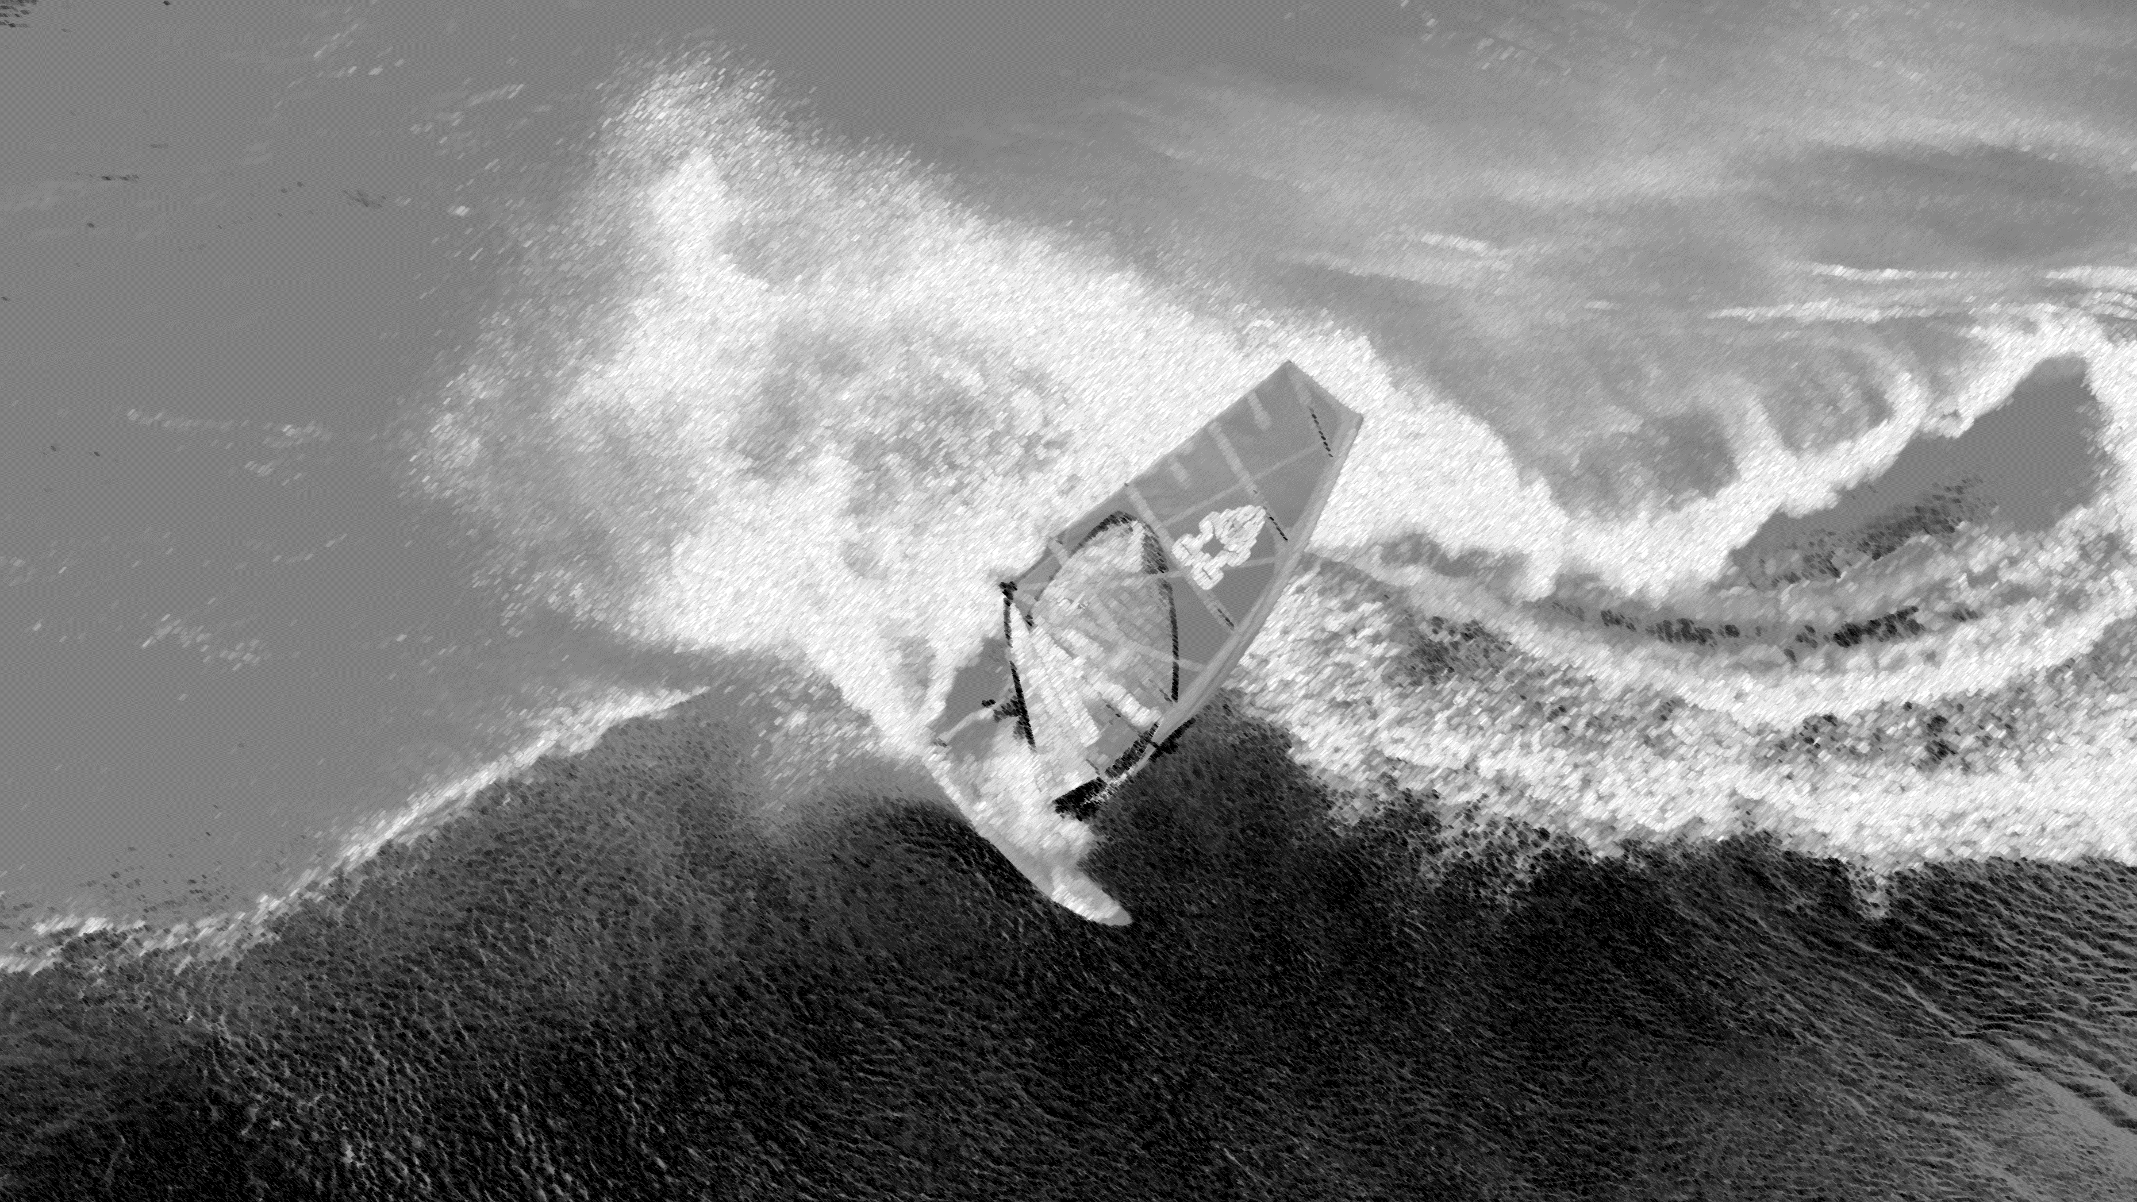
Res-Net : A dive into deeper networking
Ideas and Coding Experiments
By Group 5: Mars; Kevin; Tim

Slide 2
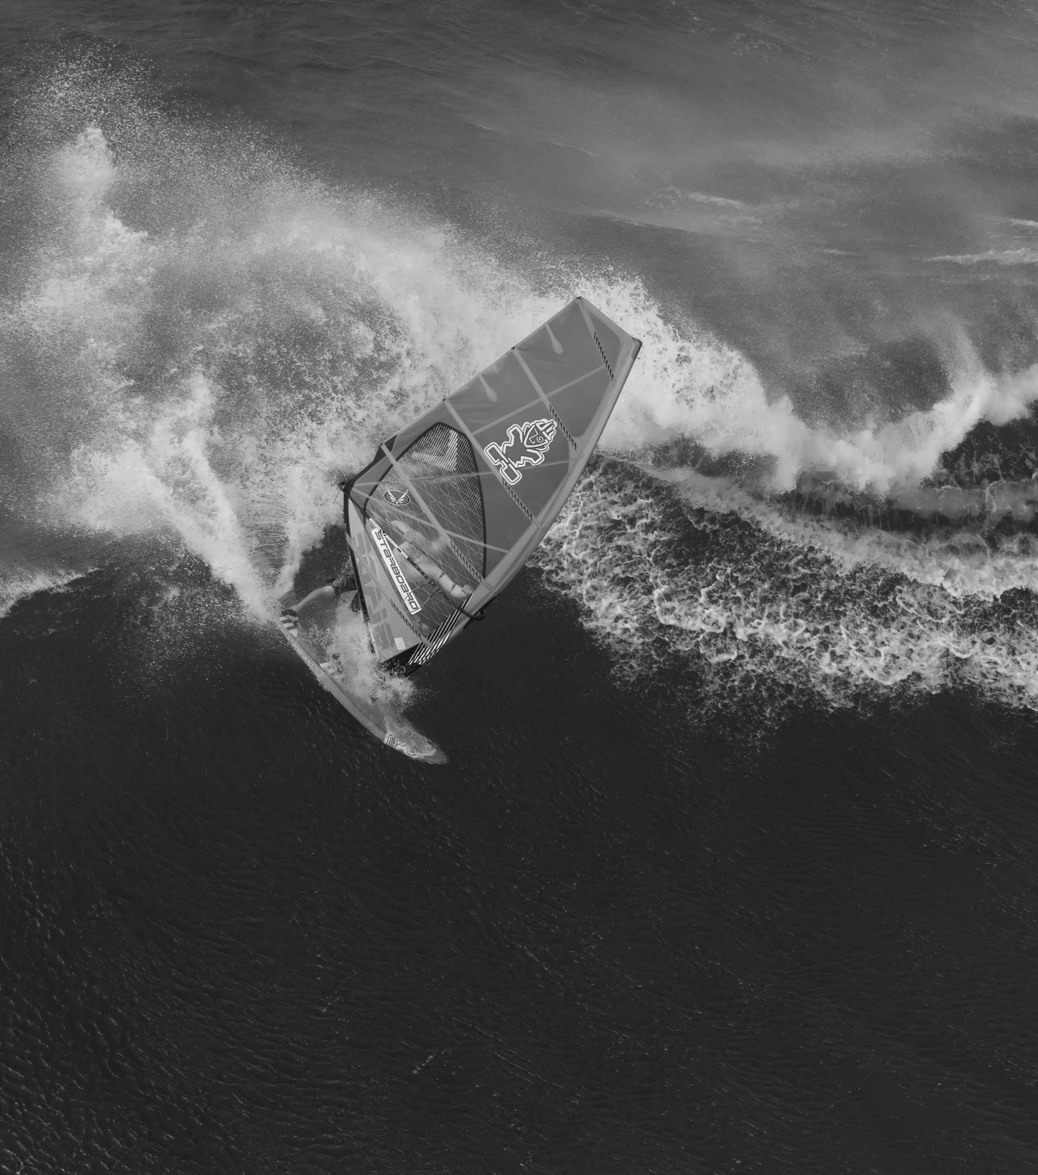
01
Background
Vanishing Gradient & Degradation
02
Method/Main Idea
Skip Connection & Identity/Residual Mapping
CONTENTS
03
Experiment Results
ResNet VS FCN VS Regular CNN
04
Further Applications and consideration
Combination of Skip Connection and more

Slide 3
01
«
Background
Vanishing Gradient & Degradation

Slide 4

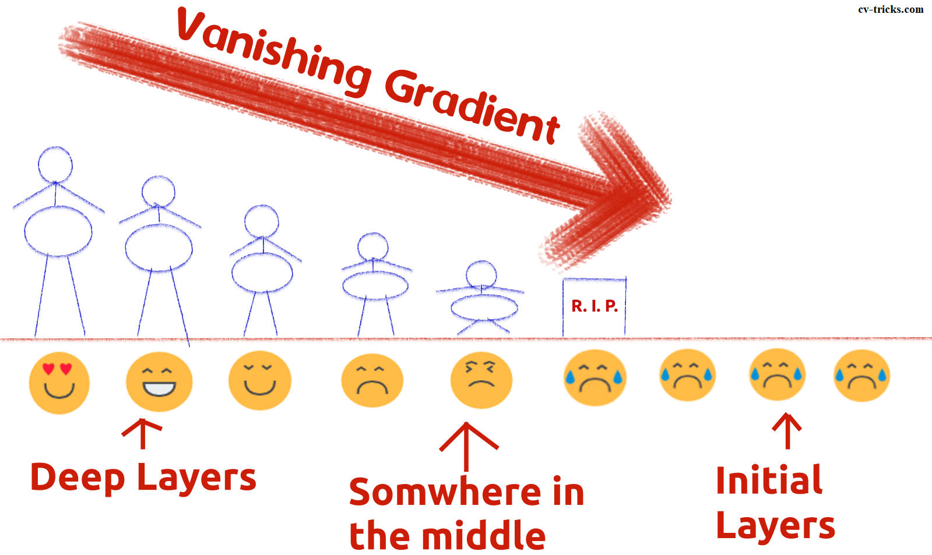
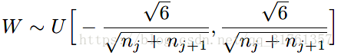
Vanishing Gradient
ROOT
Current Solution ?
The defect of the combination of active function & Back-propagation
Use alternative active function, such as ReLU, MaxOut
normalized initialization and intermediate normalization layers
When ? & Why?
Usually happens for Sigmoid &Tanh, the derivative close to 0

Slide 5
Typical Examples
Degradation
With the network depth increasing, accuracy gets saturated and then degrades rapidly. (not caused by overfitting)
Adding more layers to a suitably deep model leads to higher training error
Training error and test error on CIFAR-10
with 20-layer and 56-layer “plain” networks.
«
Source: He K , Zhang X , Ren S , et al. Deep Residual Learning for Image Recognition[C]// 2016 IEEE Conference on Computer Vision and Pattern Recognition (CVPR). IEEE Computer Society, 2016.

Slide 6
02
«
Method/ Main Idea
Skip Connection & Identity/Residual Mapping
If more layers don’t work,
we are not stacking it right !

Slide 7
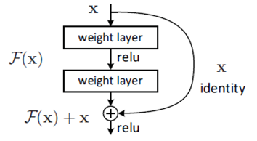
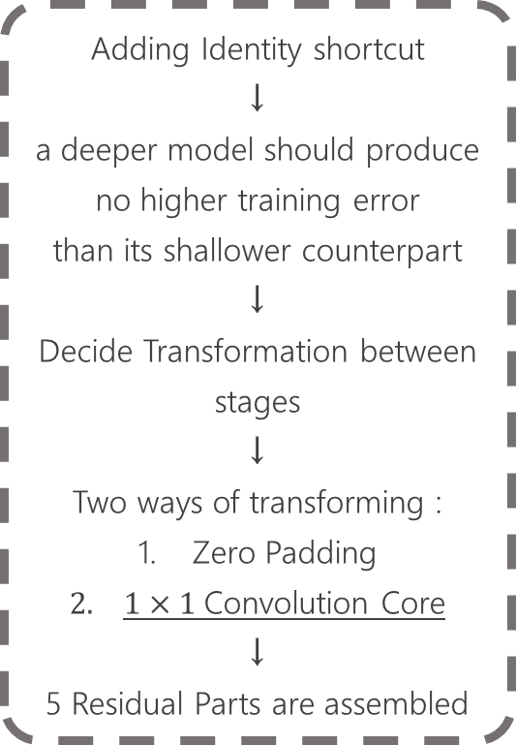
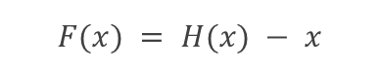
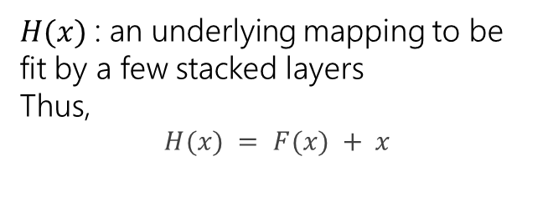
How
Skip Connection
&
Residual Mapping Works?
How to solve?
Residual Block
Adding Identity shortcut
↓
a deeper model should produce no higher training error
than its shallower counterpart
↓
Decide Transformation between stages
↓
Two ways of transforming :
Zero Padding
$1×1$Convolution Core
↓
5 Residual Parts are assembled
Introducing Identity Shortcut（Skip Connection）
Skip Connection
& Residual Mapping
«
Residual Function
$$F(x) = H(x) − x$$
$H(x)$: an underlying mapping to be
fit by a few stacked layers
Thus,
$$H(x) = F(x) + x$$

Slide 8
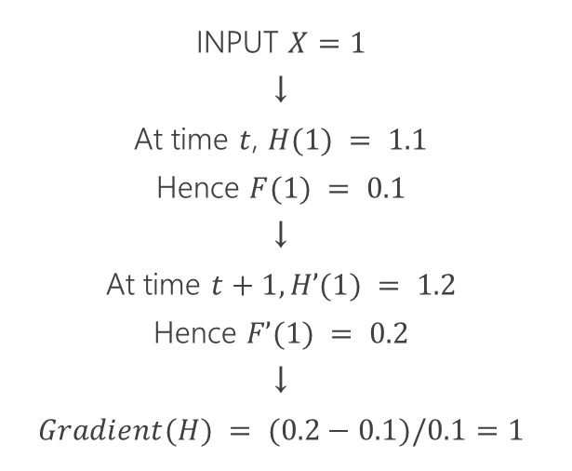
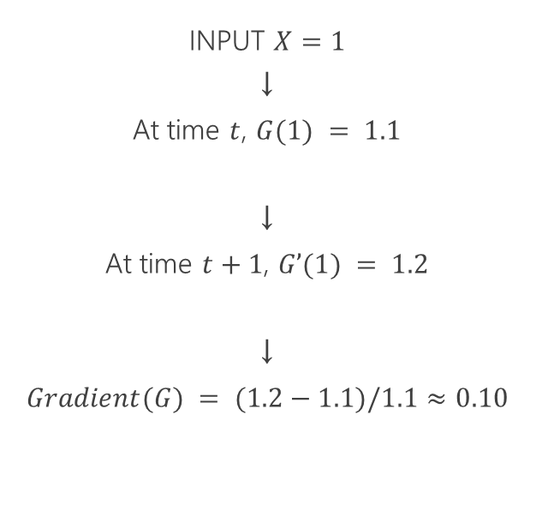
How does
skip connection
solve vanishing gradients?
Comparison:
with or without skip connection
Plain Network(G)
Res-Net(H)
INPUT $X=1$
↓
At time $t$, $G(1) = 1.1$
↓
At time $t+1$, $G’(1) = 1.2$
↓
$$Gradient(G) = (1.2−1.1)/1.1≈0.10$$
INPUT $X=1$
↓
At time $t$, $H(1) = 1.1$
Hence $F(1) = 0.1$
↓
At time $t+1, H’(1) = 1.2$
Hence $F’(1) = 0.2$
↓
$$Gradient(H) = (0.2−0.1)/0.1=1$$
The vanishing gradient problem suggests that we need to keep derivative at a considerable amount.
«

Slide 9
What Happened? Why Degradation?
Singularities
All related to the non-identifiable of the network
↓
Elimination Overlap Linear Dependence
How does skip connection solve degradation?
The degradation problem suggests that the solvers
might have difficulties in approximating identity mappings
by multiple nonlinear layers.
«
Though we have a big enough network, it is poorly expressed
Source: Orhan A E , Pitkow X . Skip Connections Eliminate Singularities[J]. 2017.

Slide 10
A DEEPER INSIGHT VIEW:
SKIP CONNECTIONS ELIMINATE SINGULARITIES
Source: Orhan A E , Pitkow X . Skip Connections Eliminate Singularities[J]. 2017.
Notes:
Skip connections between adjacent layers break the elimination singularities by ensuring that the units are active at least for some inputs,
even when their adjustable incoming or outgoing connections become zero (Figure 1a; right). They eliminate the overlap singularities by breaking the permutation symmetry of the hidden units at a given layer (Figure 1b; right). Thus, even when the adjustable incoming weights of two units become identical, the units do not collapse into each other, since their distinct skip connections still disambiguate them. They also eliminate the linear dependence singularities by adding linearly independent (in fact, orthogonal in most cases) inputs to the units (Figure 1c; right).

Slide 11

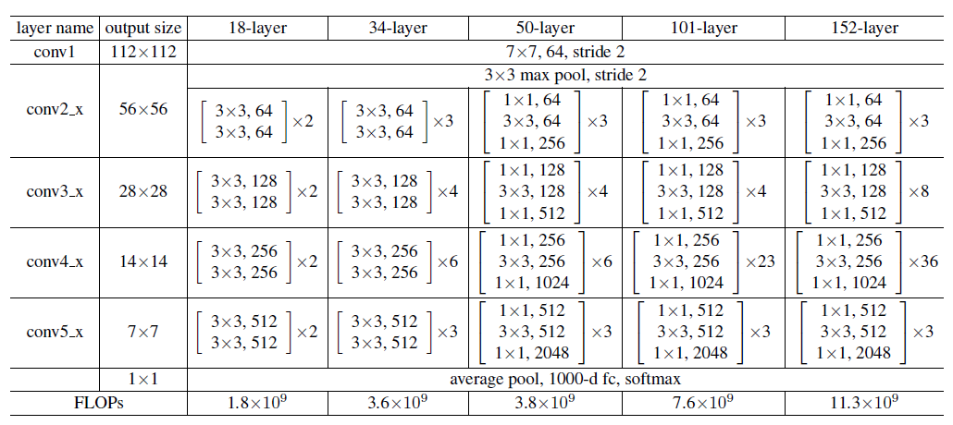
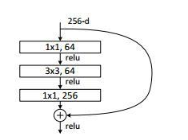
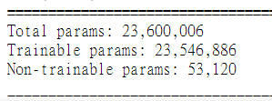
Now, we've got a functioning network
ResNet 50
#”Due to practical efficiency, usually a bottle neck version of the building block is adopted”
Batch Size:32
DBA: “Deeper Bottleneck Architectures”

Slide 12
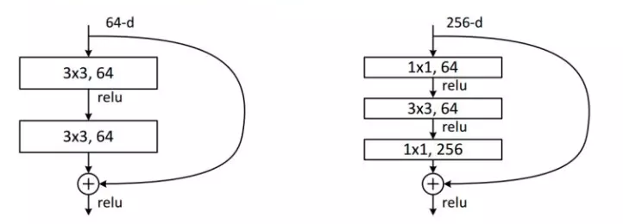
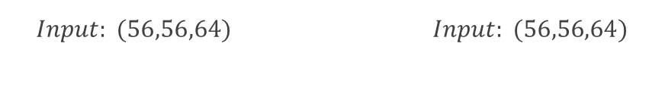
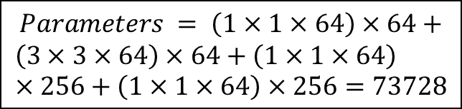
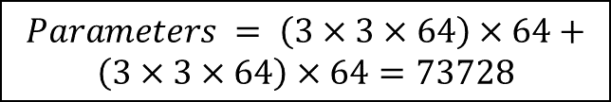
Why Bottle Neck?
It saves the number of parameters, provide the possibility of more layers within less parameters
→ more economical
Supposedly we have 2 architecture:
$$Input: (56,56,64) Input: (56,56,64)$$
identical!
$$Parameters = \left(3×3×64\right)×64+$$
$$\left(3×3×64\right)×64=73728$$
$$Parameters = \left(1×1×64\right)×64+$$
$$\left(3×3×64\right)×64+\left(1×1×64\right)×256+\left(1×1×64\right)×256=73728$$
Also, we need to address the fact that lacking fully-connected layer is another reason for less parameters in ResNet

Slide 13
3 Net Works：
ResNet50 VS Plain CNN (same layers without Short Cut) VS FCN (50 layers of fully-connected 584 nodes with drop out of 0.3,with similar amount of trainable parameters to ResNet50)
03
«
Experiment Results
A more intuitive view of the superiority of ResNet
Data Set: the original sign gesture: 1080 train images and 120
test images & CIFAR 10

Slide 14
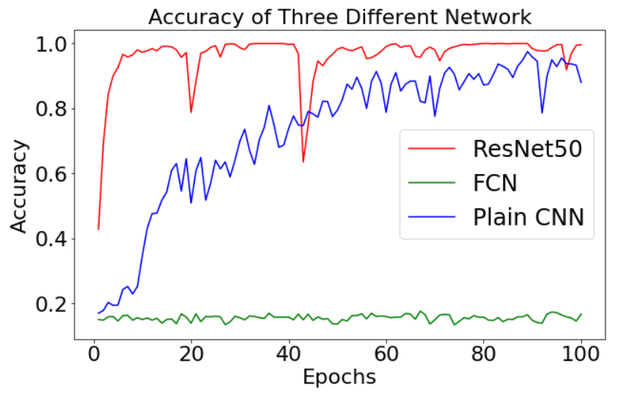
100 EPOCHS on original data set
Res Net
VS Plain CNN
VS MLP (sign)
«
What does the accuracy
behave during the training process?
Obviously, ResNet has better Accuracy.
But overfitting might occur due to the limited data size

Slide 15
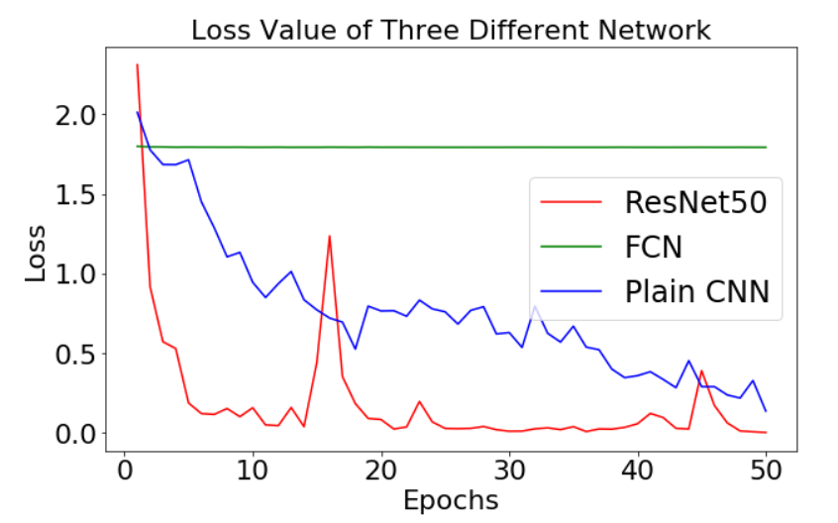
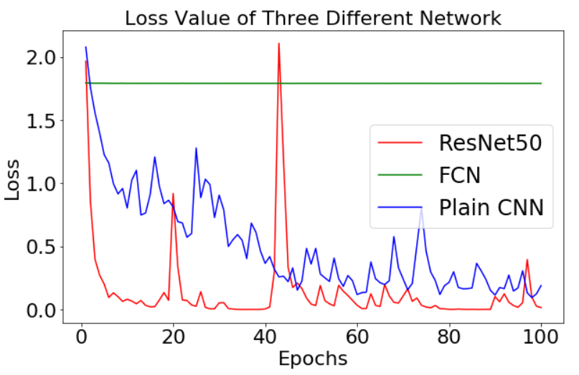
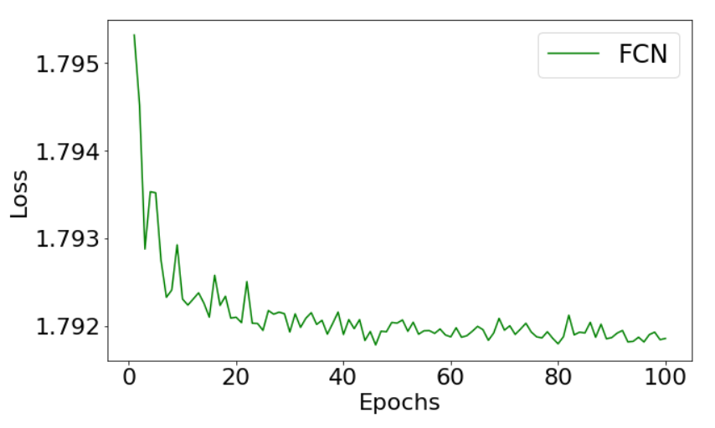
50 EPOCHS
Res Net
VS Plain CNN
VS MLP (sign)
Res Net converge faster/performs better optimization outcome
100 EPOCHS
«
Fully-Connected MLP actually have relatively scant decrease:
What does the LOSS behave during the training process?

Slide 16
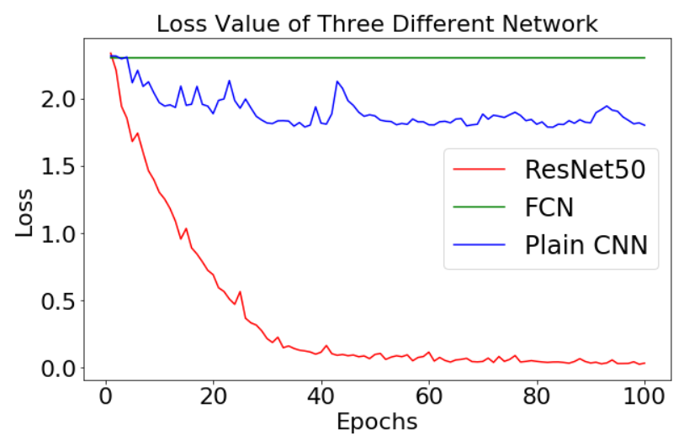
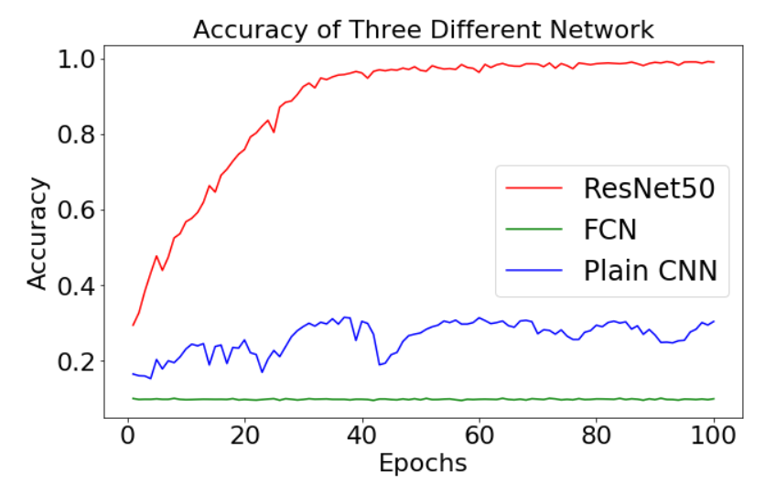
Res Net
VS Plain CNN
VS MLP (CIFAR 10)
Loss
Res Net still converge faster/performs better optimization outcome
«
What about CIFAR 10
(Much bigger data set)
Accuracy
For larger data set, ResNet show incredible good accuracy than others
and possibly degradation appears

Slide 17
04
«
Further Consideration and Applications
Combination of Skip Connection and more

Slide 18
Is XX necessary?
Global Average Pooling?
Batch Normalization?
more native to the convolution structure by enforcing correspondences between feature maps and categories. Thus the feature maps can be easily interpreted as categories confidence maps.
There is no parameter to optimize in the global average pooling thus overfitting is avoided at this layer.
It sums out the spatial information, thus it is more robust to spatial translations of the input.
We do not have fully-connected layer in ResNet
Source: Min Lin, Qiang Chen, and Shuicheng Yan. Network in network. CoRR, abs/1312.4400, 2013
Actually, no.
BN ‘s advantage is still an controversial point.
If we replace the standard initialization with “Fixup”, it might be different.
Source: Zhang H , Dauphin Y N , Ma T . Fixup Initialization: Residual Learning Without Normalization[J]. 2019.
Regularization?
Usually, we don’t need regularization.
But actually, we could increase the speed with cutout regularization:
zeroing out a random subset of each training image
35 epoch training schedule are promising with 5/5 runs reaching 94% accuracy and the median run reaching 94.3
Random Initialize Weights?
We could actually initialize with pre-trained weights in ImageNet.
Source: https://myrtle.ai/how-to-train-your-resnet-3-regularisation/

Slide 19
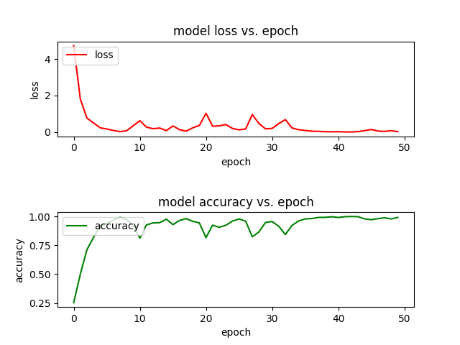
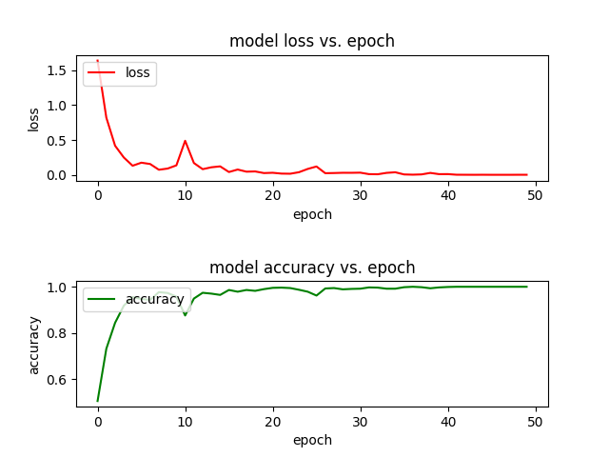
Comparison of Max Pooling
&
Average Pooling
Max Pooling
Average Pooling
Training Loss/Accuracy and test precision
Empirical > Theoretical, it lacks mathematical evidence
The coincidence probably due to small test set and similar general accuracy, thus lead to same amount of failed cases
«
Pooling Layer | Test Loss | Test Accuracy
Max | 0.1570896251748 | 0.975000023841857
Average | 0.1158091872038 | 0.975000023841857
Loss
Accuracy
Max Pooling seems to lead to higher and more unstable loss
Coincident? They have identical accuracy.

Slide 20
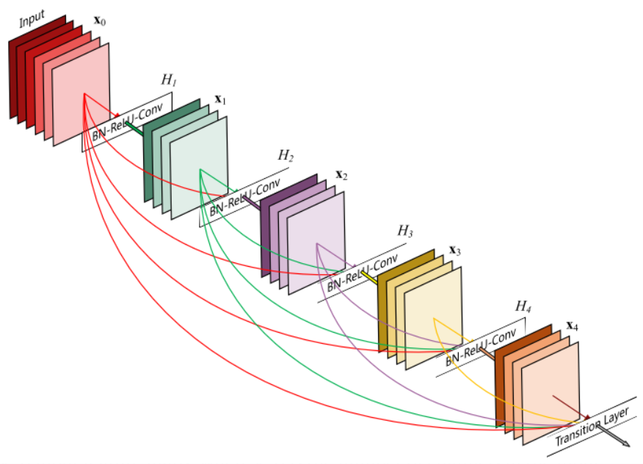
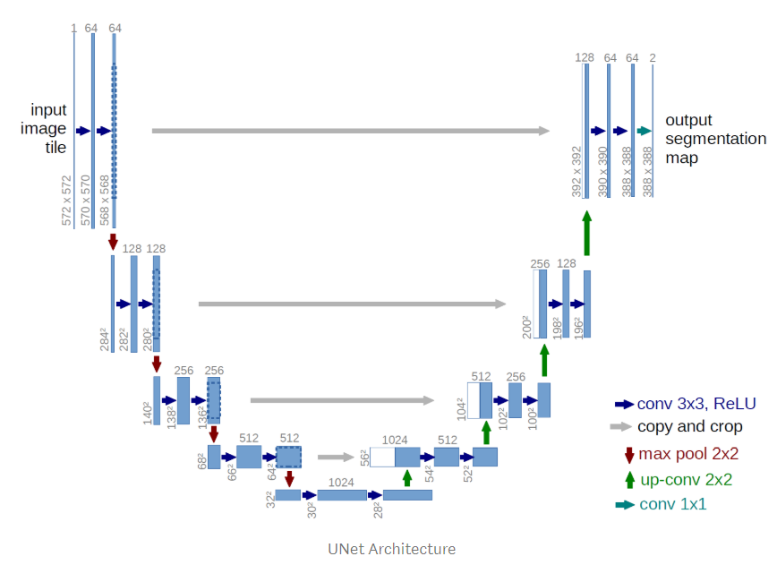
Dense Connected CNN
Further Application
Source: Huang, Gao, Liu, Zhuang, van der Maaten, Laurens,et al. Densely Connected Convolutional Networks[J].
“In fact ResNet skip connections are used in a lot more model architectures like the Fully Convolutional Network
(FCN) and U-Net. “
«
U-Net
Source: Olaf Ronneberger, Philipp Fischer, Thomas Brox. U-Net: Convolutional Networks for Biomedical Image Segmentation[C]// International Conference on Medical Image Computing and Computer-Assisted Intervention. Springer International Publishing, 2015.

Slide 21
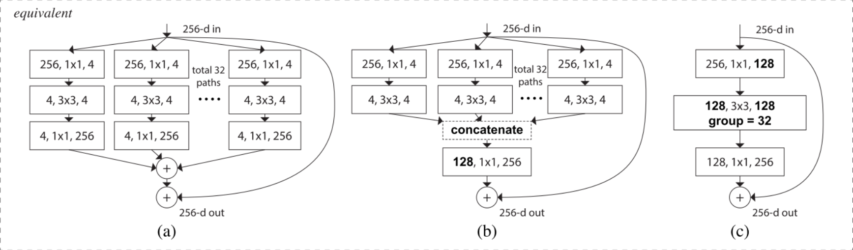
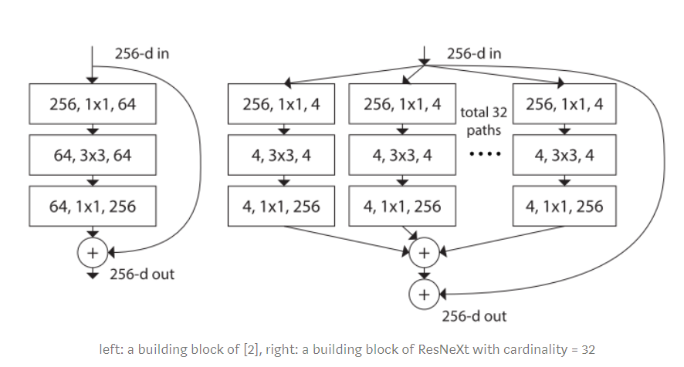
Further Application
ResNext
Source: Xie, Saining, Girshick, Ross, Dollár, Piotr,et al. Aggregated Residual Transformations for Deep Neural Networks[J].

Slide 22

Thanks!
By Group 5

